Slide 1
Boosting Algorithms in Machine Learning
Enhancing Prediction Accuracy through Ensemble Methods

Slide 2
Introduction to Boosting
- Definition: Boosting is an ensemble technique to convert weak learners into strong learners.
- Overview: Iteratively combines predictions from multiple models to improve accuracy.
- Key Idea: Focus on misclassified instances by previous models.

Slide 3
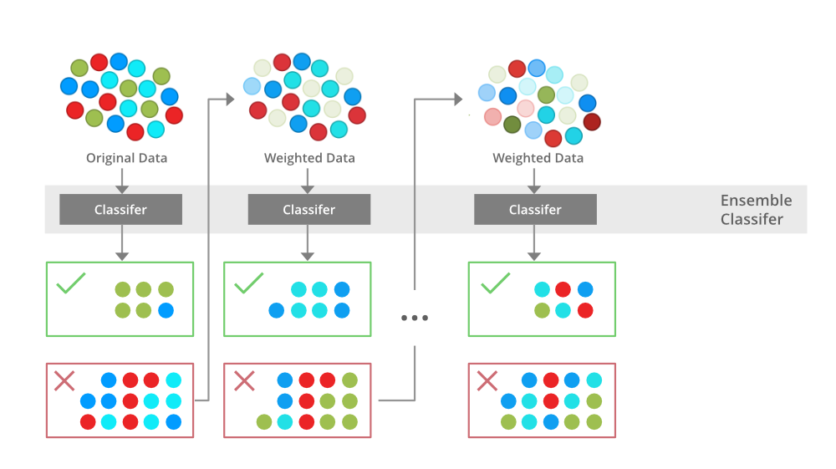
Why Boosting?
- Improves prediction accuracy.
- Reduces bias and variance.

Slide 4
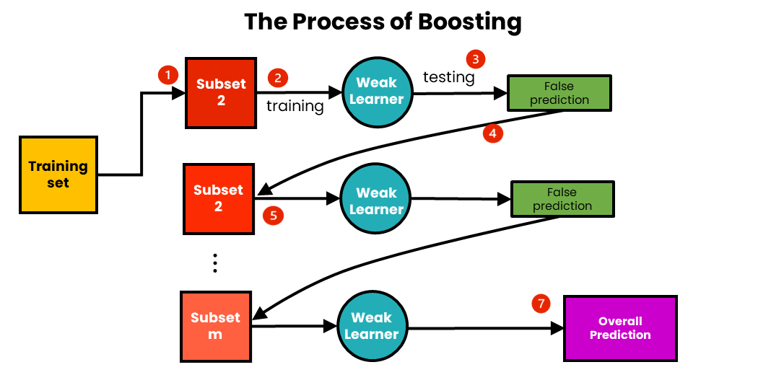
How Boosting Works
- Training starts with an initial weak model.
- Misclassified samples get higher weights.
- Successive models correct the errors of previous ones.
- Final prediction combines weighted votes of all models.

Slide 5
Types of Boosting Algorithms
1. AdaBoost (Adaptive Boosting)
2. Gradient Boosting
3. XGBoost (Extreme Gradient Boosting)
4. LightGBM
5. CatBoost

Slide 6
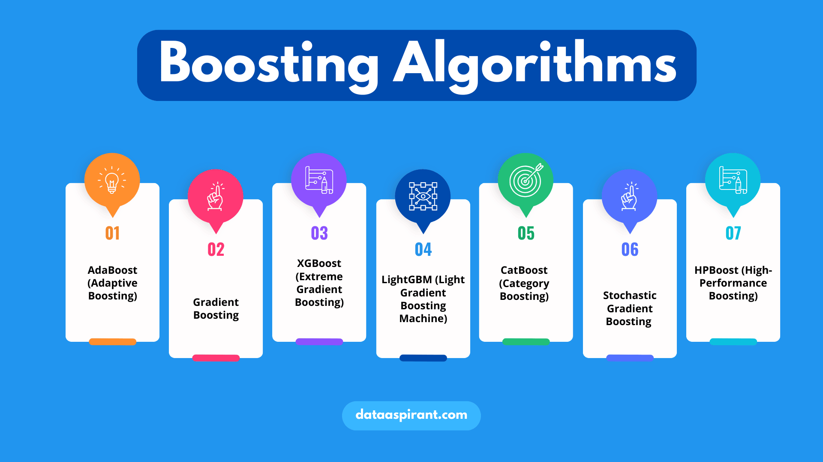

Slide 7
AdaBoost Algorithm
- Description: Sequentially applies weak classifiers (e.g., decision stumps).
- Process: Adjusts sample weights based on errors.
- Formula: Combine classifiers with weighted vote mechanism.
- Pros & Cons: Simple but sensitive to outliers.

Slide 8
Gradient Boosting
- Description: Minimizes loss by adding models sequentially.
- Key Steps: Compute gradients, fit models to residual errors, update weights.
- Applications: Regression, classification.
- Advantages: Robust performance, customizable loss functions.

Slide 9
XGBoost
- Key Features: Regularization, tree pruning, parallel processing.
- Advantages: Speed, scalability, performance.
- Use Cases: Kaggle competitions, large datasets.

Slide 10
Real-World Applications
- Finance: Fraud detection.
- Healthcare: Disease prediction.
- Marketing: Customer segmentation, churn prediction.
- E-commerce: Product recommendation.

Slide 11
Advantages and Disadvantages
Advantages:
- High accuracy.
- Versatile and adaptable.
Disadvantages:
- Computationally expensive.
- Sensitive to noisy data and overfitting.

Slide 12
Key Insights
- Boosting combines multiple models for better predictions.
- Choice of algorithm depends on dataset and task requirements.
- XGBoost, LightGBM, and CatBoost are widely used due to their efficiency.

